Slide 1
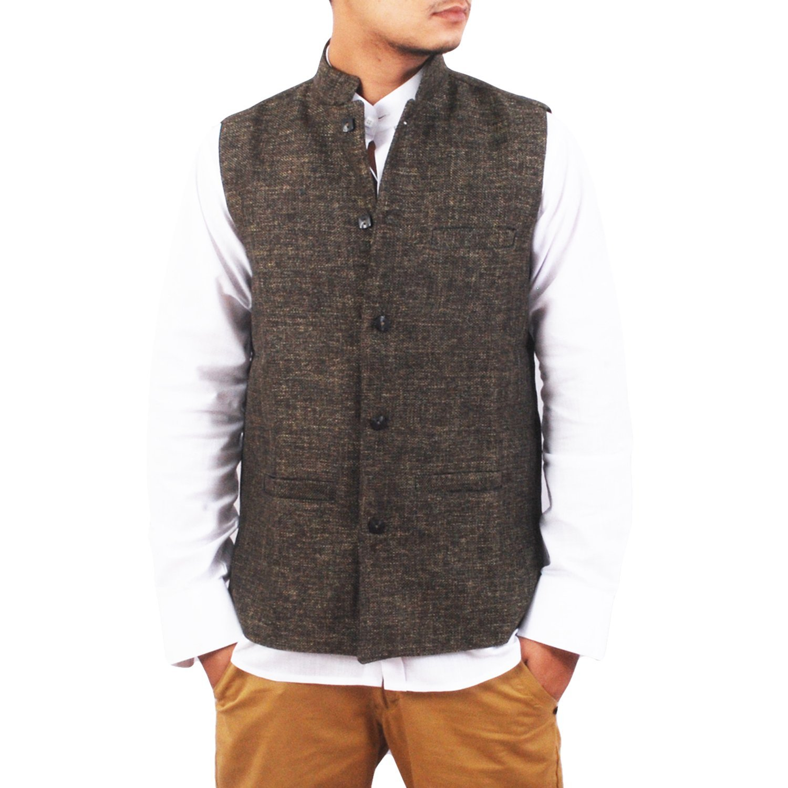
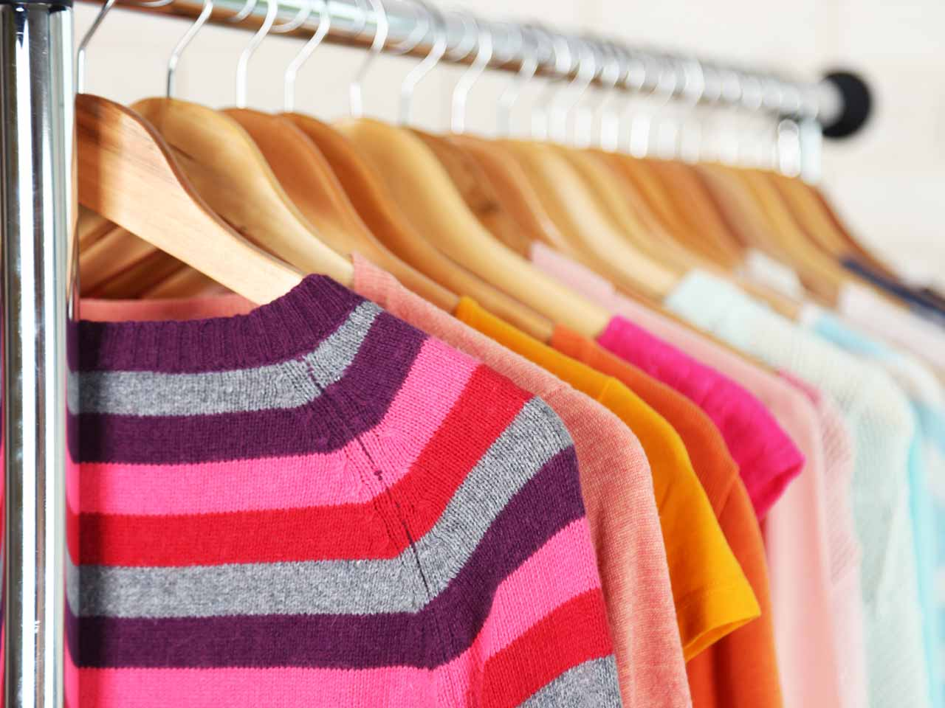
The Fashionista
Clothing Store
Group #6
Vincent Yen, Hang Gao, Yuxiao Zheng,
Siyuan Zhang, XiaoXiao Li

Slide 2

Presentation Topics
Structure Design
Data Structure/UML
User Interface
Data Set

Slide 3
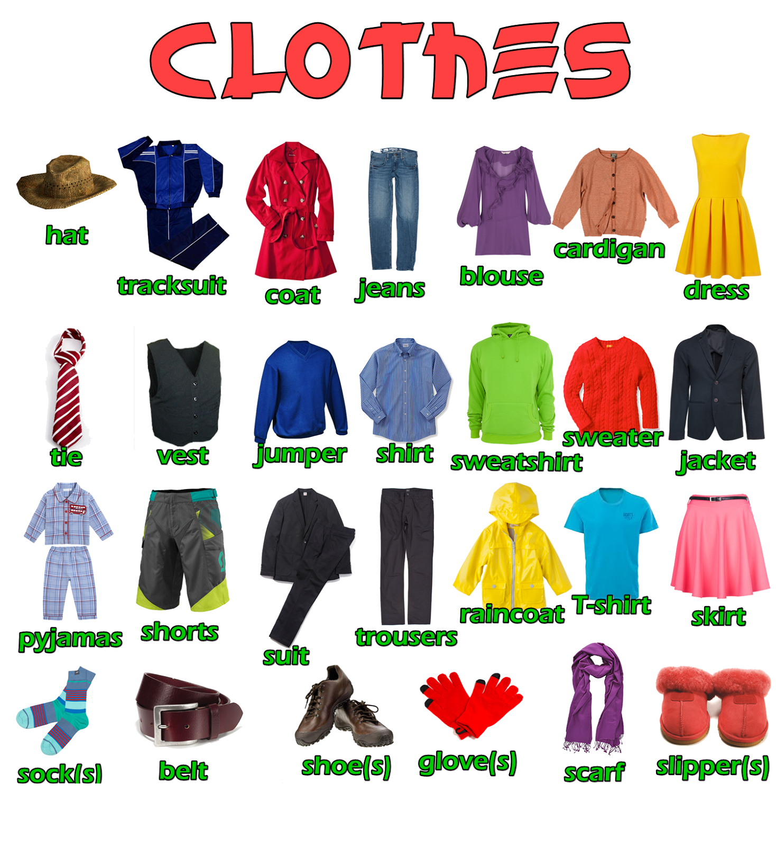
Project Overview
An online clothing store for men and women.

Slide 4

Data Set
Products
Users
Orders

Slide 5
Design Structure/Data Structure/UML
UML will be shown using image editor.

Slide 6

Testing/Debug
Memory allocation exception
Issues in manipulating data (IE. Working with private constant variables (retrieving variables and placing in lists), saving/loading information from file.
Time vs. design complexity
(ex. Regex design, shopping cart for multiple item orders)

Slide 7

Questions

